Slide 1

Starter Task
Complete the SDD Testing starter task
Attempt all questions on both sides of the page

Slide 2
Learning intentions and success criteria
I am learning…
I can…
About the Evaluation and Documentation stages of software development
How to evaluate a computer program
Describe the evaluation and documentation stages of software development
Evaluate a computer program

Slide 3

Evaluation
N5 - Software Design & Development

Slide 4
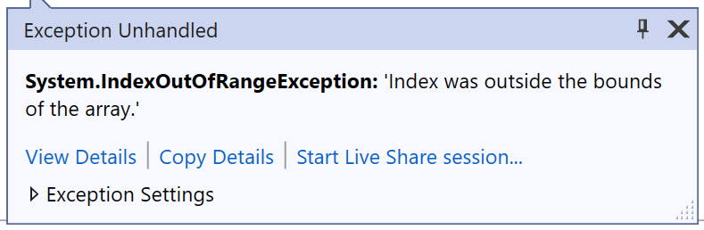
Recap: Errors
There are three types of errors you will need to know.
Syntax error:
Spelling/grammar mistakes, missing symbols, etc.
Execution error:
Asking the program to do something impossible (like divide by zero)
Logic error:
The program works but it produces unexpected results

Slide 5

Evaluation
This is the process of checking if a program meets the user’s requirements.
There are four criteria for evaluating a program:
Fitness for Purpose
Efficient use of Coding Constructs
Robustness
Readability
You should be able to evaluate a program against all four of these criteria.

Slide 6

Fitness for Purpose
This is making sure that the program does what it’s supposed to do:
Requirements are created during the analysis stage
A program is fit for purpose if it meets all the functional requirements

Slide 7
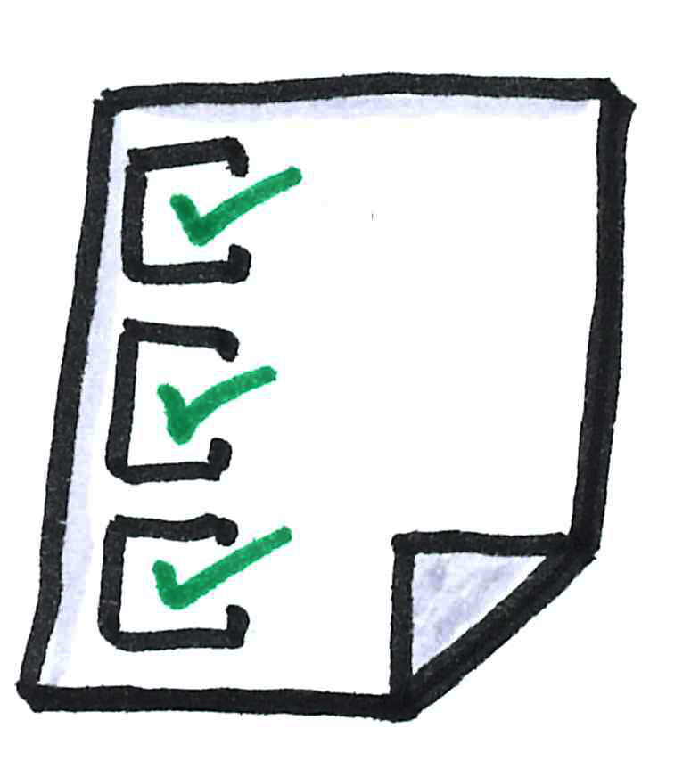
Functional Requirements
Requirements describe the specific processes and activities the program must perform.
Examples:
The program must calculate the average mark of the class
The program must validate that each mark is between 1 and 100
The program must display the average mark to the user

Slide 8

Efficient use of Coding Constructs
Questions we can ask to decide if a program is efficient:
Does it have unnecessary lines of code?
Do all the loops repeat the correct number of times?
Could the code have been written more efficiently using constructs?
Does the program make use of arrays where appropriate instead of individual variables?
Are the arrays appropriately sized to not waste memory?

Slide 9
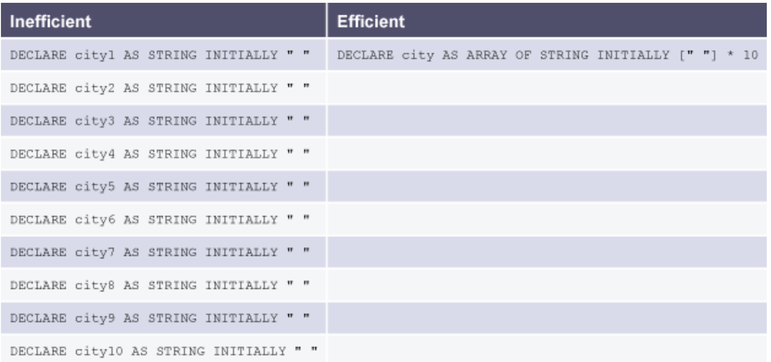
Efficiency Example 1
Can you use an array instead of repeated variables?
This would save lines of code.

Slide 10
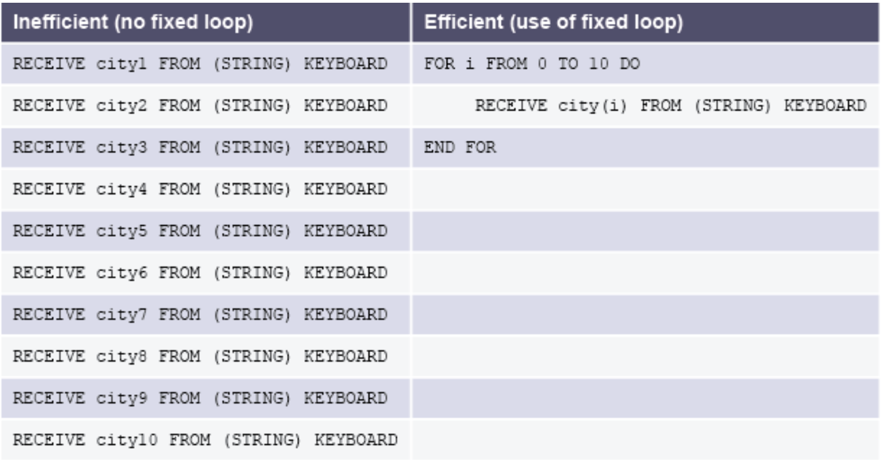
Efficiency Example 2
Can you use fixed loops instead of repeated lines of code?

Slide 11
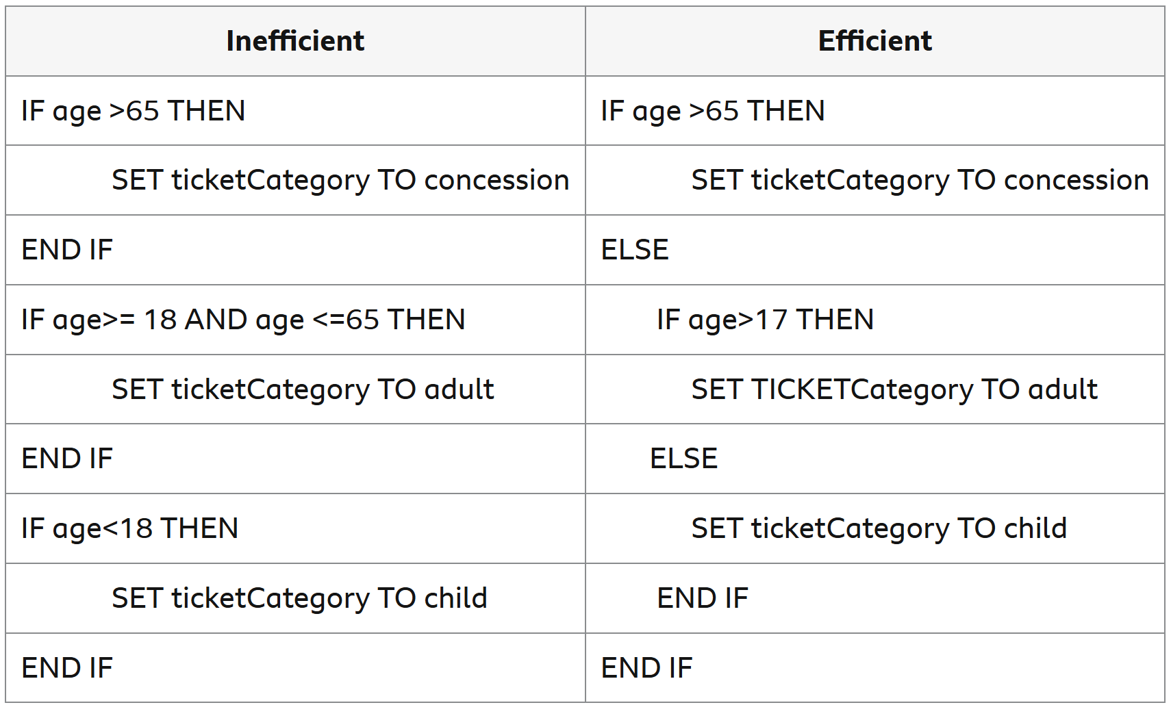
Efficiency Example 3
Can you use nested conditions instead of multiple if/else statements?

Slide 12
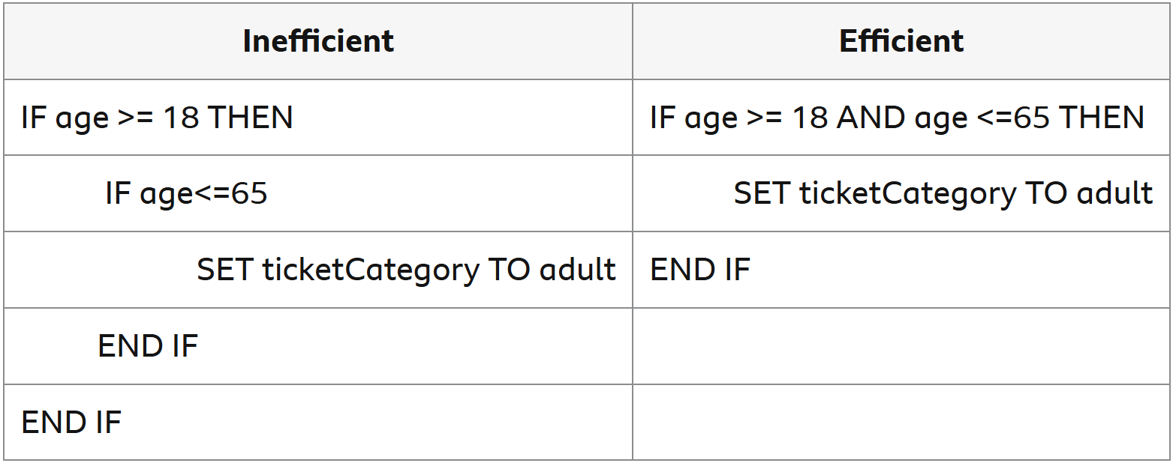
Efficiency Example 4
Can you use a complex condition instead of multiple conditions?

Slide 13

Robustness
A program is deemed to be robust if it can cope with unexpected or incorrect input.
Examples;
Entering a String when the program asks for an Integer
Entering a number outside the range the program expects
Many of these problems can be solved with input validation:
So, the program only continues once an acceptable input is entered
By using test tables, you can check that inputs do as you expected

Slide 14
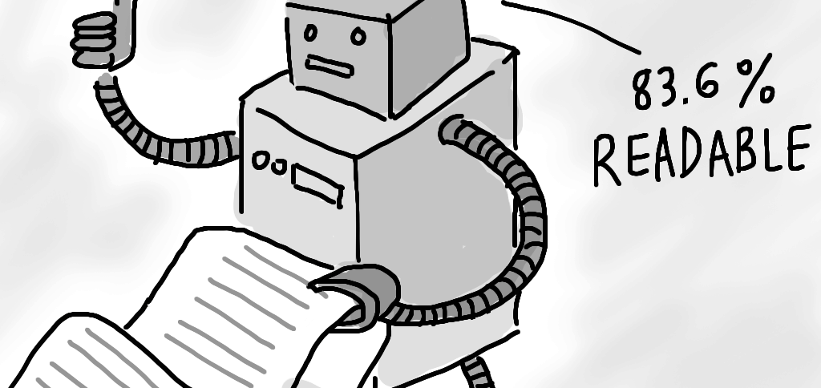
Readability
Most of the time, programmers will be working in teams, and you will have to work on other people’s code:
It is important to write code which can be read and understood by others
This can also be helpful for yourself, if you work on code you haven’t used in a while
There are four factors which can help a program be readable:
Internal commentary
Meaningful identifiers
Indentation
White space

Slide 15
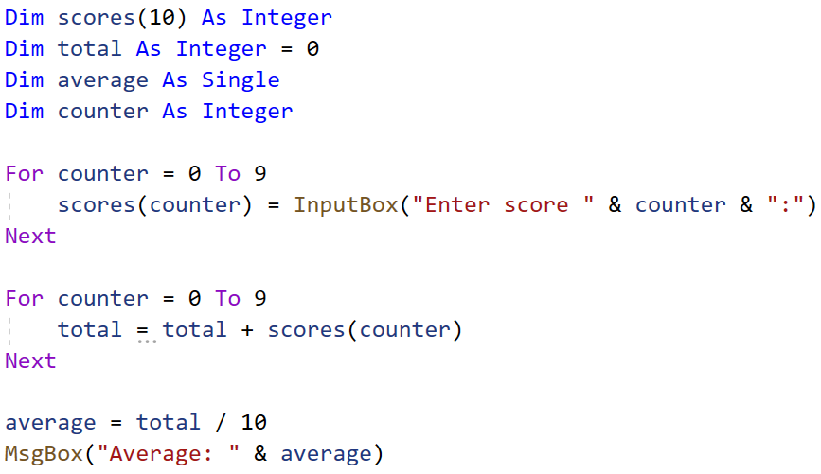
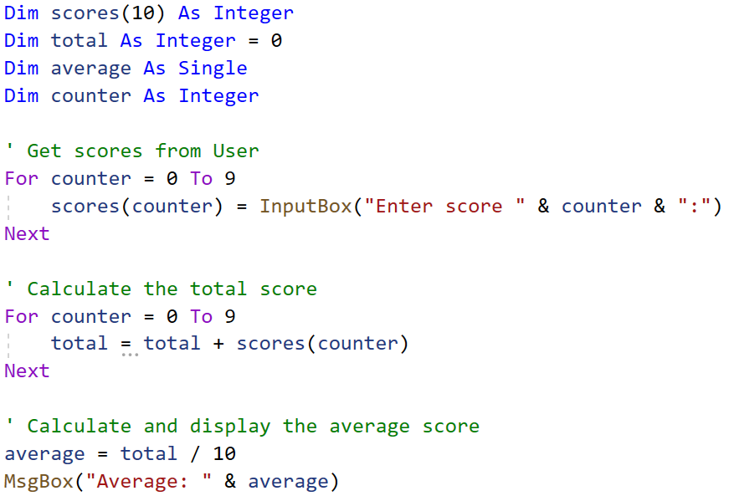
Internal Commentary
Comments let a programmer explain what their program does inside the code itself:
Lines of code which the computer ignores – they are just there to be read by humans
Without commentary
With commentary

Slide 16
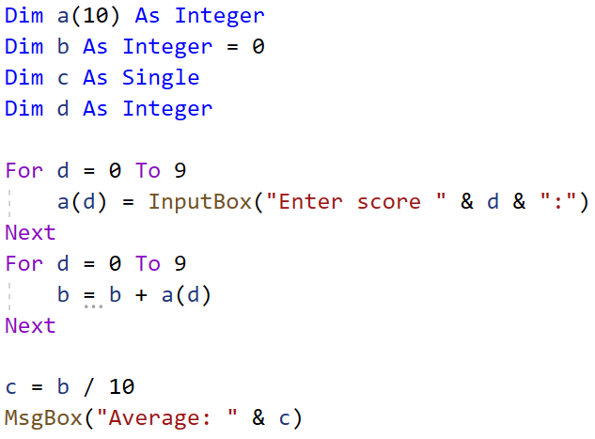
Meaningful Identifiers
When creating variables, it’s important to give them a meaningful name so that you know what it’s for.
Same program as last time but replaced variable names:

Slide 17
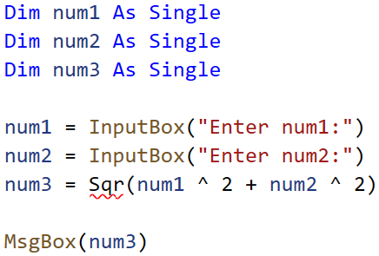
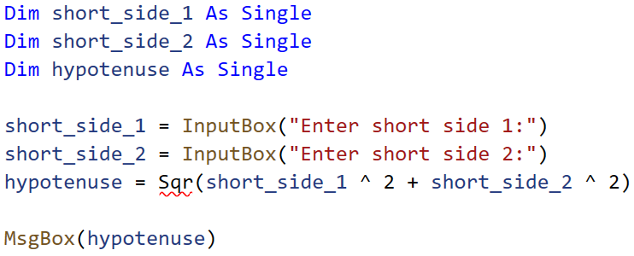
Meaningful Identifiers
A less extreme example:
Without meaningful identifiers
With meaningful identifiers

Slide 18
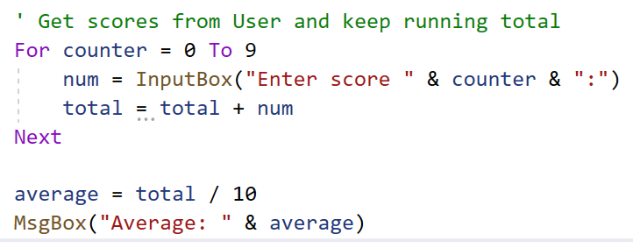
Indentation
This is when part of your code is shifted to the left to indicate that it is inside another block of code (the code hierarchy):
E.g. code in an If statement or a while loop
In most programming environments this is automatic

Slide 19
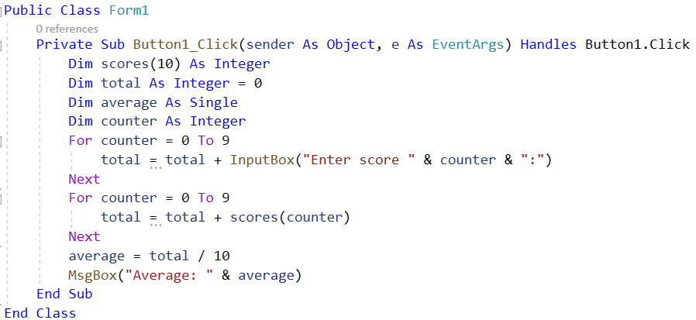
Whitespace
This is when you add blank lines of code in between sections of your program:
Helps to separate different processes in your code
Especially when your program is very large, whitespace is crucial

Slide 20
Evaluation Summary
There are four criteria for evaluating a program.
Fitness for Purpose:
Does the program meet the requirements?
Efficient use of Coding Constructs:
Are there ways to make the program more efficient (e.g. less lines, use of loops and arrays, etc.)
Robustness:
Can the program handle unexpected inputs?
Readability
Is the program easy to read and understand?

Slide 21
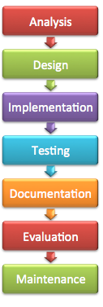
Documentation
Throughout a program’s development, documentation is created which explains what the program does.
Documentation is carried out in all stages of software development.
Development Stage | Documentation
Analysis | Software specification
Design | Wireframes, code diagrams
Implementation | Code
Testing | Test plans, test tables
Evaluation | Code report

